Slide 1
Sine & Cosine
Math
Joe James
Math & Computer Science Tutorials
from Silicon Valley

Slide 2
Unit Circle
y
Unit Circle – a circle with radius 1 unit
1
Θ
x

Slide 3
Unit Circle
y
Unit Circle – a circle with radius 1 unit
Opposite of theta = y component = rise
Adjacent to theta = x component = run
1
Θ
x

Slide 4
Right Triangles
hypotenuse
opposite
Θ
adjacent

Slide 5
Right Triangles
Sine(Θ) written as sin Θ
= y component of theta
= opposite/hypotenuse
hypotenuse
sin
opposite
Θ
adjacent

Slide 6
Right Triangles
Sine(Θ) written as sin Θ
= y component of theta
= opposite/hypotenuse
hypotenuse
Cosine(Θ) written as cos Θ
= x component of theta
= adjacent/hypotenuse
sin
opposite
Θ
cos
adjacent

Slide 7
Right Triangles
Sine(Θ) written as sin Θ
= y component of theta
= opposite/hypotenuse
hypotenuse
Cosine(Θ) written as cos Θ
= x component of theta
= adjacent/hypotenuse
sin
opposite
Θ
cos
adjacent
Tangent(Θ) written as tan Θ
= slope component of theta (rise over run)
= opposite/adjacent = sin/cos

Slide 8
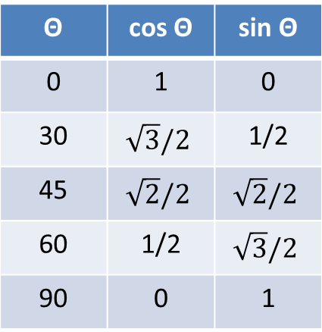
Common Angles
y
90°
60°
45°
Sin and Cosine range between -1 and +1 because they can never be longer than the hypotenuse.
30°
Θ | cos Θ | sin Θ
0 | 1 | 0
30 | $$\sqrt{3}/2$$ | 1/2
45 | $$\sqrt{2}/2$$ | $$\sqrt{2}/2$$
60 | 1/2 | $$\sqrt{3}/2$$
90 | 0 | 1
0°
x

Slide 9
Common Angles
y
90°
Sin and Cosine range between -1 and +1 because they can never be longer than the hypotenuse.
cos –
sin +
Θ | cos Θ | sin Θ
0 | 1 | 0
30 | $$\sqrt{3}/2$$ | 1/2
45 | $$\sqrt{2}/2$$ | $$\sqrt{2}/2$$
60 | 1/2 | $$\sqrt{3}/2$$
90 | 0 | 1
180°
0°
x
cos –
sin –
cos +
sin –
270°

Slide 10
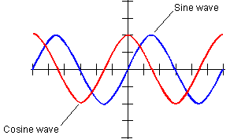
Sine and Cosine Waves
Sine and Cosine waves look identical, but are shifted by 45°
Every 90° they cross zero
They never exceed 1.0
magnitude
Sine wave
1
-90
90
180
degrees
-1
Cosine wave

Slide 11
Law of Sines
for any triangle with sides a, b, c and opposite angles A, B, C:
B
sin A
sin B
sin C
c
=
=
a
a
b
c
A
C
b
Law of Cosines
for any triangle with sides a, b, c and opposite angles A, B, C:
c² = a² + b² – 2ab cos C

Slide 12
Pythagorean Theorem
(sin Θ)² + (cos Θ)² = 1
Addition Identity
sin(x + y) = sin x cos y + cos x sin y
cos(x + y) = cos x cos y – sin x sin y
Subtraction Identity
sin(x – y) = sin x cos y – cos x sin y
cos(x – y) = cos x cos y + sin x sin y

Slide 13

© 2017 Joe James

